Slide 1
112 Spring
DBMS Final Project
Crowdfunding Platform

Slide 2
What’s the project about?
This is project about a reward-based crowdfunding platform.
What’s reward-based crowdfunding?
Initiators may need money to manufacture products. So they collect funds from others on an online platform in a form of pre-sales. In return, Sponsors can purchase the products at a discounted price.
What do you need to do in this project?
You are a database developer. Your goal is to desgin a database system handling account logging, proposal raising, sponsoring, etc.
If you’re not familiar with reward-based crowdfunding, check out platforms like 嘖嘖、flyingV、挖貝. The links to these websites can be found on the following page.
Notes:
本專案專注於募資平台中的「回報型群眾募資」又稱為「回饋型群眾募資」，回報型群眾募資指的是發起人需要集資製造物品時，藉由網路平台以預售的方式向他人索取資金，而出資者則可以用較便宜的價格預購物品，或是得到某些限量紀念性商品，台灣常見的平台包含嘖嘖、flyingV、挖貝等。
本專案之題目設計根據回報型群眾募資平台的運作方式進行設計，包含註冊為會員以及成為會員後之相關操作，例如使用者造訪網頁時的行為、註冊為會員、以會員身份進行提案、針對提案進行贊助、在對贊助商品進行評論等情境，作為設計依據。對回報型群眾募資的運作機制尚不清楚的同學，可以直接上常見平台進行瀏覽，配合期末專案簡報中的背景及條件敘述，以利寫題目時的背景揣摩。

Slide 3
Examples of Crowdfunding Platforms
https://www.kickstarter.com/
https://www.zeczec.com/
https://www.flyingv.cc/
https://wabay.tw/

Slide 4
Scenario – Proposals
Each proposal has four status: Pre-Publish, Fundraising, Expired and Terminated.
Pre-Publish (status code: 1): This is the phase when a proposer creates a proposal and is drafting the content.
A pre-published proposal is only visible to its proposer.
The goal being raised must be determined at this stage.
Proposal options must be determined at this stage.
Ongoing (status code: 2): This is the phase when a proposer publishes the proposal and starts fundraising.
The proposal content may not be modified after this point.
Expired (status code: 3): This means that a proposal reaches its end date and cannot receive further sponsorship.
Terminated (stauts code: 4): This means the proposal is no longer visible to its proposer and all members.
Notes:
* 每個提案有四種狀態: 預發佈、募款中、已過期和已終止。
* 預發佈(狀態代碼: 1): 提案人起草提案內容的階段。
* 只對提案人可看見預發佈的提案。
* 在這個階段，必須確定募資目標金額。
* 在這個階段，必須確定提案選項（商品）。
* 進行中(狀態代碼: 2): 提案人發佈提案並開始籌款的階段。
* 在這個階段，提案內容將無法修改。
* 已過期(狀態代碼: 3): 募資提案結束，會員無法再贊助該提案。
* 已終止(狀態代碼: 4): 提案人、會員、贊助者不能再看到這個募資提案。

Slide 5
Scenario – Proposals
The status of a proposal must follow the sequence “Pre-Publish (status 1) → Ongoing (status 2) → Expired (status 3)”. That means an expired status cannot be reversed to the ongoing status, and an ongoing status cannot be reversed to pre-publish.
An ongoing proposal cannot be terminated until it is expired (reaches status 3).
A proposal with pre-publish status and expired status may be terminated at any time.
Each proposal can only be submitted by one member.
Each proposal may have one or multiple fundraising options.
Options in the same propoal must have unique names.
Notes:
* 一項提案的狀態必須依循 "預發佈(狀態1) → 進行中(狀態2) → 已過期(狀態3)" 的順序。每一個裝態都是不可逆的，換句話說，已過期的狀態無法倒回到進行中狀態，進行中的狀態為預發佈。
* 進行中的提案在未過期之前無法被終止，避免會員權益遭到受損。
* 處於預發佈狀態跟已過期狀態的提案可以被終止，有兩個時機點會觸發，會員刪除提案、跟會員刪除帳號。 * 每個提案只有會由一位會員發布募資。
* 每個提案可能有一個或多個募資選項。
* 同一提案中，募資選項不能跟其他選項同名。

Slide 6
Scenario – Proposals
The fundraising period for all proposals is 30 days, inclusive of the start and the end dates.
If a proposal reaches its fundraising goal before the end date, the proposal will stay ongoing until the end of the fundraising period.
When the goal is not met but 90% of the goal (i.e. 90% completion rate) is raised by the end of the fundraising period, the fundraising period will be extended ONCE for 30 days automatically.
Only one extension is allowed.
For example, the goal is $1000 and $900 has been raised at the end of the 30th day of the fundraising period, the proposal will be extended for 30 days.
Notes:
* 所有提案的募資期限為30天,包括開始和結束日期。
* 如果一個募資提案在截止日期前達到募資目標，該提案直至募資期限結束。
* 如果在募資期限結束時沒有達到目標,但已募得90%的目標金額(即完成率 90%)，則募資期限將自動延長 30 天。
* 只允許延長一次。
* 這邊給個範例，目標金額設定在為1000 元，在 30 天的募資期限結束時，募到 900 元，那該提案的募資期限會再延長 30 天。

Slide 7
Scenario – Proposals
Each proposal belongs to one, and only one of ten categories.
Categories include music (音樂), photography (攝影), fashion (時尚), technology (科技), education (教育), games (遊戲), food (食物), place creation (地方創生), society (社會) , art (藝術),and others (其他).
Notes:
* 每個募資提案要被歸類在十個類別中的其中一個類別。
* 這些類別包括音樂、攝影、時尚、科技、教育、遊戲、食物、地方創生、社會和藝術。

Slide 8
Scenario – Members
George wants to develop a crowdfunding platform. The following description applies to all members who have registered on the platform and are logged in:
An account is associated with one user.
Members may be a proposer and a sponsor at the same time.
A proposer cannot sponsor his or her own proposal.
Only members can browse proposals. If a visitor is not a member, account registration must be required.
For members who have not sponsored any proposals, they would see the top five proposals with the most views and with ongoing status on the landing page.
When a member modifies their password, he or she must first enter the old password to confirm his or her identity.
Upon logging in, the landing page will display proposals followed by the user (if any) as well as recommended proposals.
Notes:
* 一個帳戶只會隸屬於一位使用者
* 會員可以同時是提案人和贊助人。
* 提案人不能贊助自己的募資提案。
* 只有會員可以瀏覽募資提案。如果訪客不是會員，則必須要求註冊帳戶。
* 對於尚未贊助任何募資提案的會員，他們會在首頁看到瀏覽量最多且狀態為募資中的前五個募資提案。
* 當會員修改密碼時，必須先輸入舊密碼以確認身份。
* 登入後，首頁將顯示會員關注的提案以及推薦的募資提案。

Slide 9
Scenario – Members
Members can follow multiple proposals.
Members can leave up to one review for each sponsored proposal in the reviews section and rate the proposal(1-5 points, integers) at the same time.
Reviews and rate cannot be deleted or modified.
Members can simultaneously be proposal sponsors, with each proposal being submitted by one member, who may have multiple proposals.
The proposer can reply to each review once.
Notes:
* 會員可以關注多個募資提案。
* 會員可以在評論區為每個贊助過的募資提案留下最多一條評論 ，並同時為該提案評分（1-5分，整數）。
* 評論和評分不能被刪除或修改。
* 會員可以同時成為多個募資提案的贊助人，每個提案由一名成員提出，而該會員可以有多個募資提案。
* 提案人可以對每條評論回覆一次。

Slide 10
Scenario – Members
Members may purchase up to 5 (in quantity) of the same option.
For examples, a proposal has two options, option A and option B. Member X can purchase option A one at a time in five different sittings, or five times of option A in one go. After which, option A will no longer be available for purchase for member X.
Members can only purchase options from ongoing proposals.
Notes:
* 會員最多可以購買同一選項5個（數量）。
ex: 一個提案有兩個選項，選項A和選項B。成員X可以在五次不同的情況下每次購買一個選項A，或者一次性購買五個選項A。之後，成員X將不能再購買選項A。
* 會員只能購買募資中的募資選項。

Slide 11
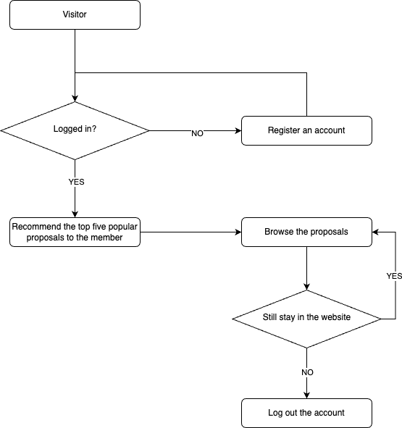
Flow Chart - Log in process

Slide 12
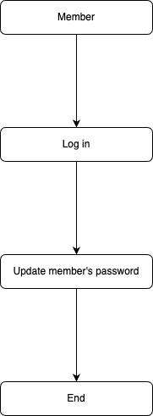
Flow Chart - Updating password process

Slide 13
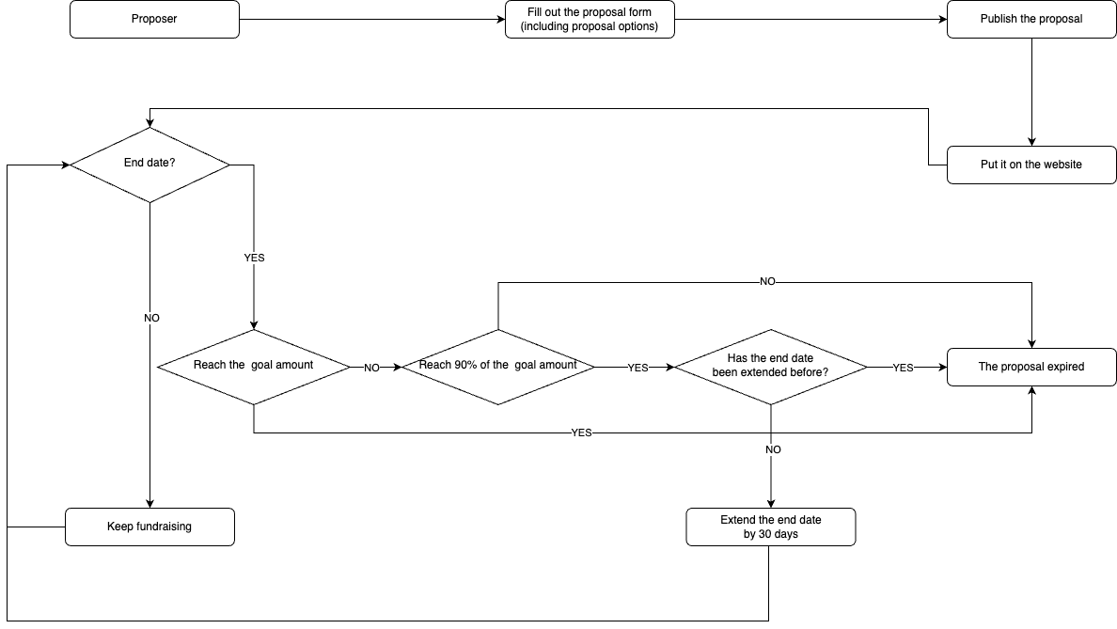
Flow Chart - Proposal Process

Slide 14
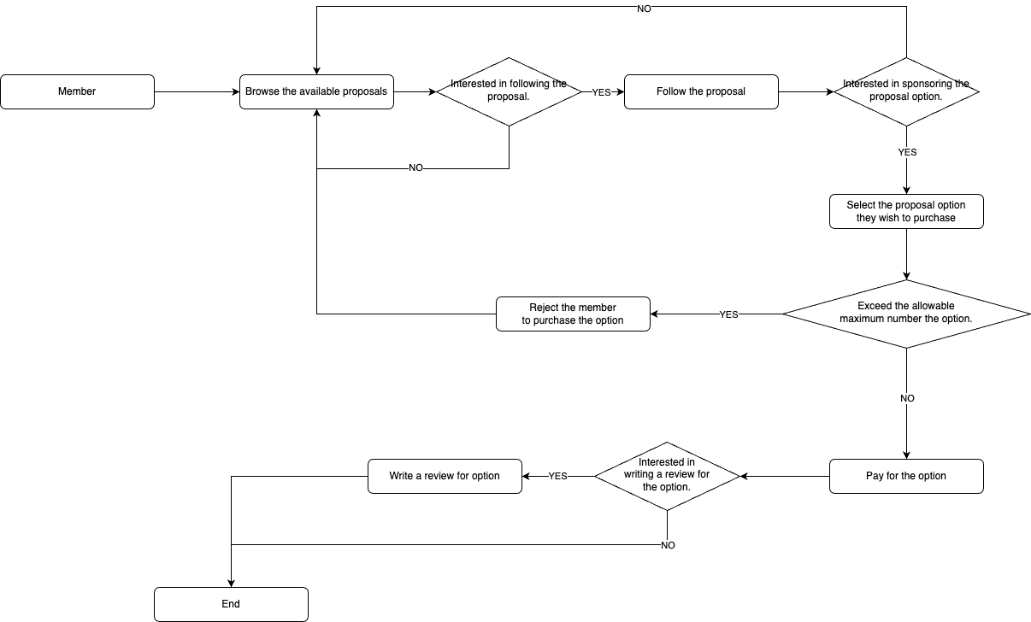
Flow Chart - Sponsoring Process

Slide 15
Entities
Your entity relation diagram must contain the following entites. You are allowed to add more entities to complete your database system.
Member
Proposal
Proposal_Option
Sponsor_Record

